Slide 1
“MALE AND FEMALE HE CREATED THEM”
June 7: “God’s Design for Men and Women”
June 14: “Male and Female in Marriage”
June 28: Male and Female in the Church”

Slide 2
“Male and Female He Created Them”
2022 Summer Seminars
Hospers Pca church
Seminar #2: “Male and Female in Marriage” (Eph. 5:22-33, etc.)

Slide 3
INTRODUCTION
Tonight after a bit of review, I hope to accomplish three goals.
1. I want to explore why the church today has so quickly capitulated to the worldly demands of the new sexual morality. Words like “surrender,” “freefall,” and “infidelity” come to mind.
2. Second, I want to consider our main subject of male and female in marriage.
3. Thirdly, I hope to think just briefly about what it means essentially to be male and female as created in God’s image.

Slide 4
REVIEW
It’s necessary that we do a bit of review. Some of you were not able to be here last time, and others of you have poor memories.
We noted that when it comes to the matters of gender and sexuality, there is much confusion in the wider culture and in the church as well.
Soon, I believe, greater pressure will come to bear on Christians to compromise on these issues.
Many are already compromising, to their great, perhaps irrecoverable loss.

Slide 6
REVIEW
And the only thing that will enable us to remain steadfast in the face of the all-demanding, all consuming new sexual morality and newly imagined sexual “rights” is to be crystal clear on what God has said.
Then it will clearly be a matter of “we must obey God rather than man,” and on that ground God’s people have never regretted their standing firm.
So we went right back to the beginning, to the first two chapters of Genesis where we find an albeit small but unspoiled humanity and several “creation ordinances” or institutions which God gave us as a foundational pattern for our existence and life together.
I suggested nine distinct yet interrelated creation ordinances or institutions.

Slide 7
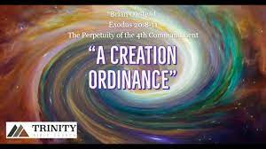

Slide 8
REVIEW
NINE CREATION ORDINANCES FROM GENESIS 1-2
1. The Creator-creature distinction
2. Human uniqueness or exceptionalism
3. The sanctity of human life
4. Gender: male and female
5. Marriage: one man, one woman
6. The blessing of work
7. Ownership of private property
8. God’s Law
9. Sabbath: six days labor, one day rest

Slide 9
REVIEW
And I suggested that all nine are under rather severe attack from the culture at large.
Why do you think this is so?
1. The primary reason is the rejection of God’s authority, God’s right to define us and to demand of us. So all of God’s ordinances must be rejected.
We want to be our own authority in all things. God’s divine claim over us has been hated from Genesis 3 on. We are witnessing this on full display every day.

Slide 11
REVIEW
2. But there is also a perfectly natural reason why all nine of these creation ordinance are under assault. God has created a world consistent with his own wisdom and character.
It is a system, a finely tuned and interdependent system. So if you deny one part eventually other parts are affected, distorted, pulled out of shape.
If you don’t work, you must somehow overthrow the right to personal property so that you can take the personal property of others: a.k.a., Marxism.
Tinker with male and female, and immediately God's design for marriage must be redefined.
Deny the Creator-creature distinction (so you can be your own god) and, oops, you necessarily lose human exceptionalism and the sanctity of human life.
We have sown the wind and we are reaping the whirlwind.

Slide 12
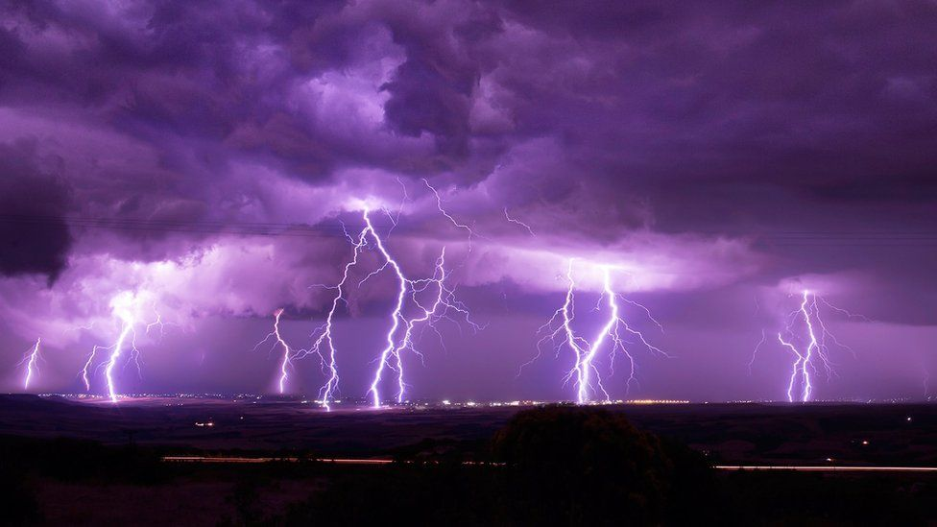

Slide 13
REVIEW
This is the ideal, God’s perfect model to which we must once again aspire as followers of Jesus. As one preacher noted, “God loves you just the way you are, and he loves you too much to leave you that way.”
Or as my friend Dr. Kevin DeYoung notes: “The Reformed tradition has always been adamant that grace does not eradicate nature or elevate nature, but grace restores nature. God is in the business of returning us to what was once declared ‘very good.’” (132)
So those who suggest that sin has so impacted some people that we just have to make some accommodations for them are not speaking biblically.
I cannot find any place in Scripture where this approach is the norm.
Rather, God is always in the business of conforming his people to the image of Christ and restoring us to true and full humanity.

Slide 14
REVIEW
And I must confess that as I consider and ponder those nine creation ordinances, the beauty and goodness of God do shine forth and do create a longing for the restoration of that biblical culture.
Humans as God’s happy creatures looking to him in love, enjoying the good things he has given like marriage and family, the blessings of work, the wisdom of his holy law, the rhythm of labor and rest, and the great privilege of being made in God’s image that we might know him and take good care of the world he has provided: it often brings me to tears.

Slide 15
A DEEPLY COMPROMISED CHURCH
And I think you can see that the church today has become deeply compromised on many of these issues by listening to the world’s drumbeat of radical feminism, radical environmentalism and animal rights, by the whole swelling spectrum of the LGBTQIA+++ sexual revolution, the incursion of Critical Economic Theory, and the pervasive amnesia regarding the Sabbath principle of work and rest.

Slide 16
A DEEPLY COMPROMISED CHURCH
If you will indulge me, I want to explore briefly why the world has made such rapid inroads into many of the churches today.
There was a small shift in the church’s understanding that opened the door or paved the way (or whatever analogy you prefer) to let worldly thinking come rolling on in.
It harkens back to the broader shift in the philosophical community during the time of the Enlightenment.
All of what I am about to say has been simplified, but the broad strokes are accurate.

Slide 17
Premodernism (325 A.D. – 1700s A.D.)
In the pre-modern, Western view, God was the source of all truth, mediated through the world he made and through the Scriptures.
Humanity could know objective truth through these means. Revelation and reason lead to the knowledge of God.
GOD
|
TRUTH/MORALITY
/ \
NATURE SCRIPTURE
\ /
HUMANITY

Slide 18
Modernism (1700s A.D. – 1960s A.D.)
In the modern, Enlightenment view, God is no longer necessary. Objective truth is still available, but it is discovered through observation and reason.
Modernism hoped that this universally recognized truth would lead to unity, peace, and progress for all. Modernism is cheerfully optimistic about the future.
GOD
|
TRUTH/MORALITY
/ \
NATURE SCRIPTURE
\ /
HUMANITY

Slide 19
A DEEPLY COMPROMISED CHURCH
But then the daunting task arose under modernism to determine how we discover the moral good.
And this became quite tricky. Instead of coming up with a single moral theory that everyone could agree with, the modern worldview proposed several different models that did not agree with each other either in their approaches or in their findings.
They could produce no universally accepted moral code. Hmm.
The two major competing theories were the “categorical imperative” of Immanuel Kant (1724-1804) vs. the “utilitarianism” of Jeremy Bentham (1748-1842) and John Stuart Mill (1806-1873).

Slide 20
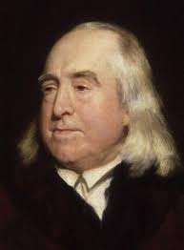
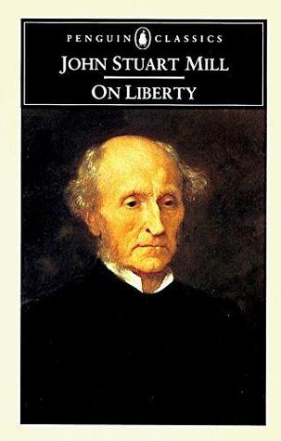

Slide 21
A DEEPLY COMPROMISED CHURCH
Utilitarianism, which is probably the dominant model in most peoples’ thinking today simply states that what is right will produce “the greatest good for the greatest number.”
That also sounds fine in theory, but what if you don’t happen to be in the “greatest number” category?
And how do you determine what is “good” for people? Is it temporary happiness? Could correction and discipline be “good” for people even if they do not like it or want it? In practice, this theory doesn’t work out so well.
But here’s where most people are today.
Good for people = the moral good. And…
“Good for people” = “what people think or feel is good”

Slide 22
A DEEPLY COMPROMISED CHURCH
In other words, personal preference, personal choice makes something right, morally right and good.
In philosophy this is called “ethical egoism”: whatever I feel is good and right for me is right.

Slide 23
A DEEPLY COMPROMISED CHURCH
So how did the church get drawn so easily into this quagmire?
By confusing the two “Great Commandments!”
When Jesus was asked about the greatest of all commandments, he did not hesitate but replied: "You shall love the Lord your God with all your heart and with all your soul and with all your strength and with all your mind, and your neighbor as yourself." (Luke 10:27)
And he went on to point out that these two commandments summarized all of the commandments.

Slide 24
A DEEPLY COMPROMISED CHURCH
Now how do these two commandments relate to one another?
Certainly they are complimentary with no conflict or contradiction between them.
If we are truly loving God we will also love our neighbor.
By loving God we would obey his command to love our neighbor as well.
Love for God = obeying his commands, and
Love for neighbor = obeying God’s commands.

Slide 25
A DEEPLY COMPROMISED CHURCH
But here’s how the church stumbled.
They subsumed the first great commandment under the second. They focused mainly on loving neighbor, doing good to neighbor.
And they forgot that loving neighbor = obeying God and obeying God’s commands.
And over time they imagined that loving neighbor meant doing “good” to your neighbor. (Sometime look up “the social gospel.”)
But “good” was no longer tethered to God’s law and God’s commands.

Slide 26
A DEEPLY COMPROMISED CHURCH
“Good” in time became equivalent to doing what made your neighbor “happy,” whatever your neighbor wanted.
But that sounds a lot like utilitarianism:
Good for people = the moral good
And how do you define “good for people”?
The world already had a definition for “good for people,” and it was “happiness as the individual defines it.”
And if the individual defines their happiness in ways that violates God’s law, what then? This is where the church stumbled: by failing to love God according to his commandments.

Slide 27
A DEEPLY COMPROMISED CHURCH
Last time I opened with the story of a woman I’d met in jail who asked a burning question.
She had a step-daughter who thought she maybe liked girls as well as boys.
“And what’s wrong with that? Don’t you want her to be happy?”
The moral good = happiness as the individual defines it.
So to suggest that the girl not act on this desire would be immoral because it would inhibit her happiness as she defined it (the highest moral good).

Slide 28
A DEEPLY COMPROMISED CHURCH
So what went wrong in the church?
The church forgot that God our Maker knows better than we do and promises true and ultimate goodness, everlasting joy to those who submit to him and follow him and his way.
So if we truly love God we will trust him to define right and wrong and happiness for us.
And if we truly love neighbor then we will not rest until they come to know the Lord and find their eternal joy and rest in him.
Think of it, the Christian’s desire for their unbelieving neighbor (and for all people!) is their everlasting joy and eternal wellbeing, something even greater than their unbelieving neighbor desire’s for himself!
As Gandalf told Bilbo in Bag End,

Slide 30
MALE AND FEMALE: MARRIAGE
God has a lot to say about marriage in his Word. Last time we considered God’s institution of marriage in the second chapter of the Bible.
I remind you that when Jesus was asked about the enduring value of marriage, he mainly quoted from Genesis 2, obviously endorsing it.
But the clearest and most extended text on Christian marriage in God’s Word is found in Paul’s writing in Ephesians 5:22-33, and I invite you to turn there.
And here in this text, Paul explains the ultimate reason for Christian marriage, a reason that was not known prior to his time. The passage is not long.

Slide 31
Ephesians 5:22-33
“²² Wives, submit to your own husbands, as to the Lord. ²³ For the husband is the head of the wife even as Christ is the head of the church, his body, and is himself its Savior. ²⁴ Now as the church submits to Christ, so also wives should submit in everything to their husbands.

Slide 32
“²⁵ Husbands, love your wives, as Christ loved the church and gave himself up for her, ²⁶ that he might sanctify her, having cleansed her by the washing of water with the word, ²⁷ so that he might present the church to himself in splendor, without spot or wrinkle or any such thing, that she might be holy and without blemish. ²⁸ In the same way husbands should love their wives as their own bodies. He who loves his wife loves himself. ²⁹ For no one ever hated his own flesh, but nourishes and cherishes it, just as Christ does the church, ³⁰ because we are members of his body. ³¹ “Therefore a man shall leave his father and mother and hold fast to his wife, and the two shall become one flesh.” ³² This mystery is profound, and I am saying that it refers to Christ and the church. ³³ However, let each one of you love his wife as himself, and let the wife see that she respects her husband.”

Slide 33
MALE AND FEMALE: MARRIAGE
Several observations:
1. Whenever I read this passage with married couples or couples applying for marriage, I always try to caution them to read their own part and not the other part.
If a husband reads the wife’s part about submission, he will naturally ask himself whether or not she is submitting to him properly. And he will tend to ignore his own part.
Or if the wife reads her husband’s part about loving her, she will concentrate on his part and tend to neglect her own. So read your own part and try to ignore the other one.

Slide 34
MALE AND FEMALE: MARRIAGE
2. There is no general command that wives should submit to all men.
It is a serious, unbiblical error to require that all women should submit to all men.

Slide 35
MALE AND FEMALE: MARRIAGE
3. The big surprise and the rich glory of this text is in the analogy Paul draws between the relationship of the husband and wife and of Christ and his church.
It’s signaled by the repetition of the words “as” or “in the same way.”
“This is supposed to be like that.”
This (marriage) is supposed to reflect, portray, depict, reveal the glory of the relationship between Christ and the church.
And this kicks everything in Christian marriage up to a new level.
It is more demanding to start with, because this really is not primarily about husbands and wives.
And it is more glorious for the same reason.

Slide 36
MALE AND FEMALE: MARRIAGE
4. The husband is to love his wife AS Christ loved the church AND gave himself up for her.
Suddenly the notion of the domineering, demanding, despotic husband as the cruel potentate in the home vanishes into smoke.
If a husband is not dying daily to himself for the sake of his wife, as a servant leader, then he is not acting like a Christian husband.
I have heard many women say or write that if they could find a husband who operated like that, they would gladly submit to him in all things.

Slide 37
MALE AND FEMALE: MARRIAGE
We are skipping ahead to our last seminar just a bit, but consider what the writer of Hebrews says to the church members he is addressing in Hebrews 13 Hebrews 13:17:
“Obey your leaders and submit to them, for they are keeping watch over your souls, as those who will have to give an account. Let them do this with joy and not with groaning, for that would be of no advantage to you.”
That’s the same idea. It only makes sense to cooperate with those who are wisely working toward your best interest. Why would you resist?

Slide 38
MALE AND FEMALE: MARRIAGE
5. The wife’s role has become increasingly difficult in our ultra-feminist day.
Some of your fellow women may look down on you with distain if you obey the Lord in this matter.
But, what else is new? Non-Christians have never really apprehended the beauty of the glory of God’s design in anything. That’s why we’re in the mess we are today.
Thankfully, there seems to be some backlash against the feminist “have it all” scheme.
Some are declaring that “Trad Wives Matter” (“Trad” stands for “Traditional”).
Some families are turning to Christ contra mundum, “against the world” and are finding a superior life, and are also finding some curious feminists reevaluating their own lives.

Slide 39
MALE AND FEMALE: MARRIAGE
6. I have to register my dissent from a popular, purportedly Christian book that claims to be based on this text.
The book by an author with the unlikely name of Emerson Eggerichs (PhD in child and family ecology, Michigan State University) and titled Love and Respect: the Love She Most Desires, the Respect He Desperately Needs.

Slide 41
MALE AND FEMALE: MARRIAGE
(Red flags should already be waving when we find a wife’s respect of her husband elevated to the level of a “need.”)
It was a New York Times Bestseller that has sold over 1.6 million copies.

Slide 42
MALE AND FEMALE: MARRIAGE
The basic idea is this:
In Ephesians 5:33 husbands are commanded to love their wives and wives are commanded to respect their husbands.
So, Eggerichs concludes, wives must therefore “need” love and husbands must therefore “need” respect. (He has it exactly backwards!)
And so if either reneges and refuses to meet this emotional or psychological “need” in the other, then the couple is plunged into what he calls the “crazy cycle” which goes like this:

Slide 43
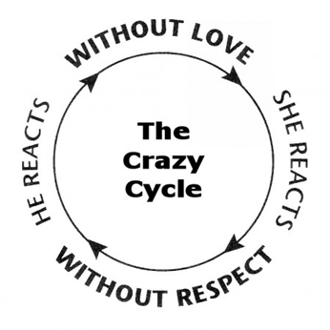

Slide 44
MALE AND FEMALE: MARRIAGE
His basic mistake is where he begins, with humanistic pop psychology based on humanistic philosophy.
The particular brand he’s been drinking is called “codependency.”
It pictures people essentially as “empty love tanks” that need somehow to be filled.

Slide 45
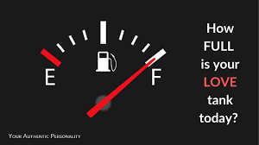

Slide 46
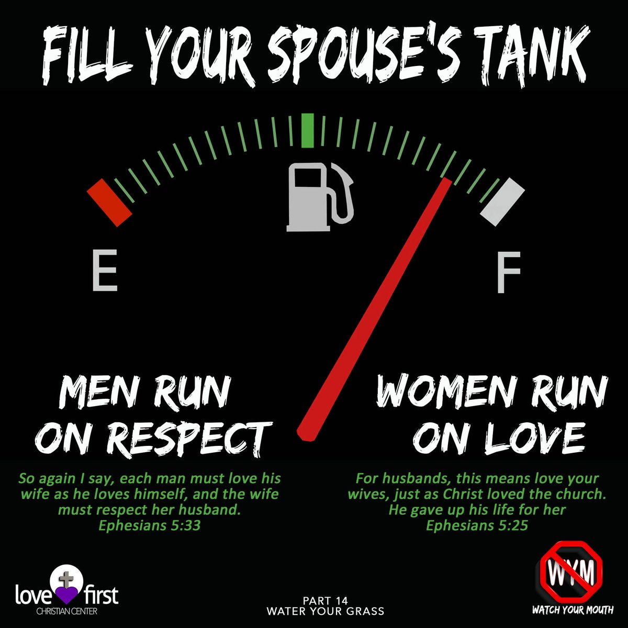

Slide 47
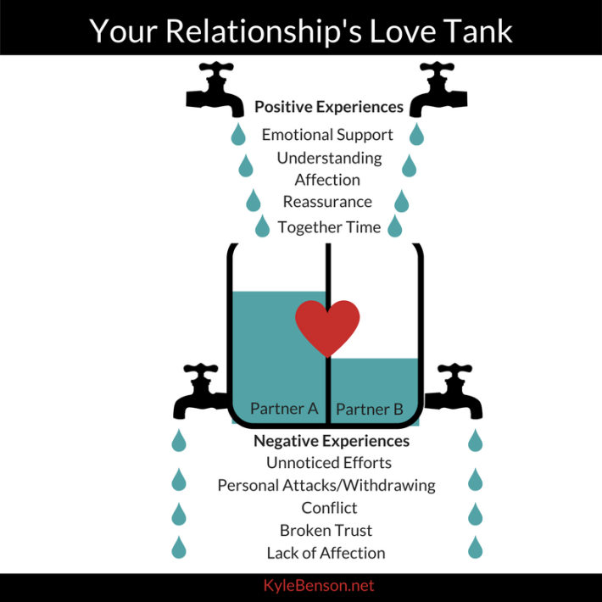

Slide 48
MALE AND FEMALE: MARRIAGE
If we have a full tank, we will be happy, and we can then will naturally be nice and pleasant and easy to get along with.
You can see how this is dripping with unbiblical, humanistic philosophy: “people are absolutely good, our feelings are always good, if we are loved and affirmed we will remain good, but if we are not loved and affirmed by everyone then we will be wounded and drawn into ourselves.”

Slide 49
MALE AND FEMALE: MARRIAGE
According to this theory, a husband’s love tank needs to be filled with the high octane brand of love known as “respect,” while the wife’s love tank takes a different variety simply called “love” but which probably means “affection, security, affirmation, and perhaps romance” of the Hallmark Movie Channel variety.
But are people “basically good”? Will they do the right thing if they have their “respect-love” or “romance-love” tank full to the brim?
If people have their particular love tanks filled up, will they behave themselves and everything will hum along swimmingly?
That is not a biblical worldview.
The Bible is very clear about why men are commanded to love their wives and why wives are commanded to submit to and respect their husbands (and it has nothing to do with any “love tank” nonsense).

Slide 50
MALE AND FEMALE: MARRIAGE
We learn from the first chapter of the Bible that God created man in his own image, “male and female he created them.”
That means that men and women are uniquely gifted, wired, equipped, and so different from one another.
And husband and wife are to relate to one another from their unique perspectives and work together using their complimentary strengths.

Slide 51
MALE AND FEMALE: MARRIAGE
But sin entered into the world, spoiling and ruining men and women and causing us to rebel against God’s design.
(In other words, people are NOT basically good.)
So, what if Paul tells husbands that they must love their wives NOT because her romance-love tank needs filling but because husbands are rebellious sinners who naturally refuse to love their wives because they love themselves too much?
That certainly sounds like a more biblical explanation than the empty love tank, pop psychology theory.

Slide 52
MALE AND FEMALE: MARRIAGE
And what if wives are called to submit to their husbands and respect their husbands NOT because the husband’s respect-love tank needs filling but because the Bible tells us that wives are rebellious sinners who respect themselves above all and are not willing to submit to anyone?
That also sounds far more biblical as an explanation than the empty love tank, pop psychology theory.

Slide 54
MALE AND FEMALE: MARRIAGE
The love tank theory lends itself to creating that grave danger I warned you about last time, creating that most prized of statuses today, the…
Victim!
As I said last week, if you love someone you will work and pray with all your powers to keep them from degenerating into the coveted victim status, for once they fall into that quicksand, they will almost never be able to recover.
All their problems are the fault of somebody else, because a victim can never be at fault.
So it becomes nearly impossible for the victim to do honest self-examination and repent.

Slide 55
MALE AND FEMALE: MARRIAGE
And what if there is a Bible passage that teaches that the non-victim, non-empty love tank view is indeed the correct way of understanding this?
Well, there is!
It comes in the third chapter of the Bible as God is informing our first parents about the consequences of sin and how that has disrupted their lives and relationships. It’s in Genesis 3:16:
^{“16} To the woman he said, “I will surely multiply your pain in childbearing; in pain you shall bring forth children. Your desire shall be for (or against) your husband, but he shall rule over you.”

Slide 56
MALE AND FEMALE: MARRIAGE
Most commentators and scholars take those last two lines to be negative.
Eve has rebelled against God’s authority, and now her natural bent will to rebel against her husband’s authority as well.
And Adam’s response will not be the “Christ gave himself up for her,” sacrificial love for his wife but to rule, dominate her as his greater physical strength will allow him to do.

Slide 57
MALE AND FEMALE: MARRIAGE
So the pattern is pretty clear. Fallen, sinful husbands do not naturally love their wives sacrificially, as Christ loved the church.
Kevin DeYoung notes, “Whenever husbands are domineering or abusive toward their wives, this is not a reflection of God’s design, but a sinister perversion of it.” (33)
Hence the husband’s real NEED (if we can use that word) is to conquer his own selfish heart, even his selfish demand for respect, and love his wife “as Christ loved the church.”

Slide 59
MALE AND FEMALE: MARRIAGE
And fallen, sinful wives do not naturally and eagerly submit to their own husband, but more naturally want to take charge.
Kevin DeYoung writes: “Just as sin desired to have mastery over Cain, so the woman, tainted by sin, desires to have mastery over her husband.” (33)
And the wife’s real NEED (instead of filling her romance-love tank) is to learn to adopt that God-ordained role of submitting to and respecting her own husband.

Slide 60
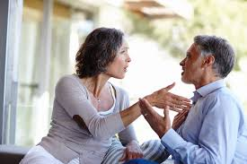

Slide 61
MALE AND FEMALE: MARRIAGE
One of the divinely appointed uses of marriage after the fall is for the sanctification of the husband and wife.
Placed in this pressure cooker of daily distractions, decisions, and disagreements, God intends for the husband to learn in new and ever increasing ways what it means to serve his wife by loving her and giving himself up for her, which after sin entered the world, does not come naturally to him.
And God also intends for wives to learn the true glory of submission to her husband “as the church submits to Christ in everything” which does not come naturally to her.
The husband serves his wife and gives himself to her in a specific, God-ordained way.
And the wife serves her husband and gives herself to him in a different but no less God-ordained way.

Slide 62
BREAK
“MALE AND FEMALE HE CREATED THEM”
June 7: “God’s Design for Men and Women”
June 14: “Male and Female in Marriage”
June 28: Male and Female in the Church”

Slide 63
HUSBANDS AND WIVES AS UNIQUELY MALE AND FEMALE
I cannot stress again how calm and compassionate, but also bold and biblical is Kevin DeYoung’s book Men and Women in the Church: A Short, Biblical, Practical Introduction.

Slide 64
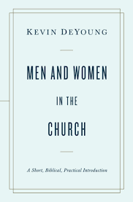

Slide 65
HUSBANDS AND WIVES AS UNIQUELY MALE AND FEMALE
And in the first chapter he offers no less than fifteen observations about manhood and womanhood from the opening chapters of Genesis.
I’m going to simply list them with minimal comment, and maybe he can help me climb out of the hole I have dug for myself.

Slide 66
HUSBANDS AND WIVES AS UNIQUELY MALE AND FEMALE
1. “First, the man and the woman were both created in the image of God.” This is explicitly stated in Scripture. So our status before God as men and women both created in God’s image is one of essential equality.
2. “Second, man has both singularity and plurality.” Humans are humans. All humans are human. But every human is either male or female.
“The way the creation account spells out sexual difference is so obvious that we can miss its importance.” This is the only identity marker of differentiation that God mentions in this context.

Slide 67
HUSBANDS AND WIVES AS UNIQUELY MALE AND FEMALE
3. “Third, the man and the woman were given joint rule over creation. Together they were to fill the earth and subdue it.”
4. “Fourth, within this joint rule, the man and woman were given different tasks and created in different realms.”
Basically, the man was created out of the garden and placed into the garden to guard and protect it. Eve was created in the garden itself.
“The creation mandate—filling the earth and subduing it—applies to both sexes, but asymmetrically. The man, endowed with greater biological strength, is fitted especially for tilling the soil and taming the garden, while the woman, possessing within her the capacity to cultivate new life, is fitted especially for filling the earth and tending to the communal aspects of the garden.”

Slide 68
HUSBANDS AND WIVES AS UNIQUELY MALE AND FEMALE
5. “Fifth, man was given the priest-like task of maintaining the holiness of the garden.” The one explicit command was given to him alone. So the man was responsible for declaring and guarding God’s command, upholding his moral boundaries.
6. “Sixth, the man was created before the woman.” This may not seem important, for lions and tiger and bears (and worms) were created before the man.
But the Apostle Paul points to this as grounds for his command in 1 Timothy 2:11-13: “¹ Let a woman learn quietly with all submissiveness. ¹² I do not permit a woman to teach or to exercise authority over a man; rather, she is to remain quiet. ¹³ For Adam was formed first, then Eve….” (Notice the reason.)
Adam was made first, implying a greater responsibility.

Slide 69
HUSBANDS AND WIVES AS UNIQUELY MALE AND FEMALE
7. “Seventh, the woman was given as a helper to the man.” This does not in any way diminish her value, for often God himself is called our “helper” (same word in the Hebrew “ezer”). It is a functional word. Adam had been given a task, the creation mandate. But he could not fill and subdue the earth by himself, and so Eve was given as his helper.
“Eve was created from man (Gen. 2:22)—equal in worth—and she was also created for man (2:20)—different in function.
8. “Eighth, the man was given the responsibility for naming every living creature.” He was given this task and apparently accomplished it before the creation of the woman.
And twice, Adam names the woman. This is telling. “In receiving their names from Adam, the rest of the living creatures, including the woman, benefit from the man’s creative cultivation and authority.”

Slide 70
HUSBANDS AND WIVES AS UNIQUELY MALE AND FEMALE
9. “Ninth, the man and the woman were created in different ways.” The man God made from the ground, the woman from man’s side.
“Not surprisingly, the man is tasked with tending to the health and vitality of the ground from which he came, while the woman is tasked with helping the man from whom she came.” Equal in their being and dignity, but different in function.
10. “Tenth, the names ‘man’ and ‘woman’ suggest interdependence. In the Hebrew “man” is “ish” and “woman” is “ishah.” It’s not true in all languages, but the interconnection is seen in English as “man” and “woman.”
This connection is deliberately blurred by the new, feminist spellings of “woman” to “womxn” and “women” to “womyn.” The Apostle Paul makes this interconnection explicit in 1 Corinthians 11:11-12: “¹¹ Nevertheless, in the Lord woman is not independent of man nor man of woman; ¹² for as woman was made from man, so man is now born of woman. And all things are from God.”

Slide 71
HUSBANDS AND WIVES AS UNIQUELY MALE AND FEMALE
11. “Eleventh, in marriage, the man leaves his family and holds fast to his wife.” We might naturally think that man would be in the lead and that the woman would give up her family and join with the husbands.
“This makes sense when we realize that the sexual differentiation is not about first place and second place, but about natural order and design. The inner world of the garden, radiating out from the family, is shaped by the help and nurture of the woman.”
Kevin also points out that in general, the woman keeps closer contact with her family than does the man.

Slide 72
HUSBANDS AND WIVES AS UNIQUELY MALE AND FEMALE
12. “Twelfth, the two came from one flesh and became one flesh.” So the “one flesh” union is essential to marriage.
This I point out to my ethics students when discussing the oxymoron of “gay marriage." Marriage already has a definition that includes vows and sexual intercourse, the “one flesh” union. Sorry, but that’s biologically impossible for same-sex unions.
“Marriage must be, and can only be, between a man and a woman, because marriage is not just the union of two persons but of the re-union of the complimentary pair.”
Kevin DeYoung quotes John Calvin: “’Something was taken from Adam in order that he might embrace, with greater benevolence, a part of himself.’ Adam may have lost a rib, but he gained a far richer reward, ‘since he obtained a faithful associate of life; for he now saw himself, who had before been imperfect, rendered complete in his wife.”

Slide 73
HUSBANDS AND WIVES AS UNIQUELY MALE AND FEMALE
13. “Thirteenth, Adam is reckoned as the head and representative of the couple.”
Remember, Adam alone was given the command. And after they fell, even though Eve initiated it, God confronted Adam first. God held Adam ultimately responsible. Paul makes this explicit in Romans 5:12: “Therefore, just as sin came into the world through one man, and death through sin, and so death spread to all men because all sinned….”
14. “Fourteenth, the man and the woman experience the curse of the fall in different ways, each in their fundamental area of responsibility.”
Adam is to till the soil, but the soil will not cooperate with him or recognize his authority any longer. And Eve is to become the mother of the race, to “be fruitful and multiply.” But his will only be through pain and suffering.” (Ladies, moms, you can blame Eve for that one.)

Slide 74
HUSBANDS AND WIVES AS UNIQUELY MALE AND FEMALE
15. “Fifteenth, the relational wholeness between the man and the woman has been ruptured by the curse.”
And now each refuses to treat the other according to his or her unique gift and calling.
The man will naturally love himself first, and the woman will naturally respect herself first, as we have already seen.

Slide 75
HUSBANDS AND WIVES AS UNIQUELY MALE AND FEMALE
KDY points out that among these fifteen observations we do not find a lot of specific commands. Rather we find a host of “divine patterns and assumptions,” or “creative capacities for men and women, not ironclad constraints.
The man’s capacities lead him to “naming, taming, dividing, and ruling,” while the woman’s primary calling is more in “filling, glorifying, generating, establishing communion, and bringing forth new life.”
And he reminds us that God saw all that he had made, and “behold, it was very good.”

Slide 76
THE ESSENTIAL MALE AND FEMALE
So that leads us to ask if anything is essentially male or female. If we would be faced with the same question that was posed to Supreme Court nominee Ketanji Brown Jackson, “Can you define ‘woman’?” how would we answer?
We should admit that some aspects of male and female are relational, male as compared to female.
If there is no male-female interaction going on, some dynamics might drop out.
(Although I would argue that an all girls school might look a bit different from an all boys school, unless you are in the former Soviet Union perhaps.)
But if a man is stranded alone on a desert island, does he still have to remember to put the toilet seat down?

Slide 77
HUSBANDS AND WIVES AS UNIQUELY MALE AND FEMALE
And yet the essential differences remain, and that’s why God made us male and female: equal, alike, different, yet complimentary.
I hinted last time that there are clearly some aspects of male and female that have been culturally constructed and are not really taught in Scripture.
Esau seemed to have been a “man’s man,” a “Grizzly Adams,” outdoorsman type, the favorite of his father.
Jacob seemed to be more of a mama’s boy, who hung around the kitchen a lot, a favorite of his mother’s.
Yet Jacob essentially married four women at the same time and fathered twelve rambunctious sons, as well as at least one daughter, becoming the father of the nation of Israel.
Is it more “manly” to be an outdoorsman than to be a cook?

Slide 78
HUSBANDS AND WIVES AS UNIQUELY MALE AND FEMALE
I like to cook.
There, I said it.
I’m somewhat embarrassed of the fact that I enjoy cooking, but it’s mainly because I enjoy eating what I want to eat.
And, I have to admit that it’s mainly indoor cooking, not the manly “carve a slab off the vicious animal you’ve just slain with your bare hands and blacken it on a bonfire” kind of cooking (although I have butchered whole hogs before, after shooting them in the head and cutting their throats with a butcher knife!).
So some of the “traditional” roles for men and women are more “traditional” than they are biblical, and we need to be careful that we do not confuse the two.

Slide 79
HUSBANDS AND WIVES AS UNIQUELY MALE AND FEMALE
Now if you’re a bit squeamish, perhaps you will prefer Kevin DeYoung’s take on essential manhood and womanhood to that of my own, which I will share in a bit.
KDY points to the right kind of “strength” as the essential for men and the right kind of “beauty” as the essential for women. Who could disagree? “From this passage (1 Peter 3:1-7), I conclude that the crowning characteristic of a woman is true beauty and the crowing characteristic of a man is true strength.”
Men are to display the right kind of strength toward their wives: “not frightening and domineering but honoring and understanding. Men were made to be strong, usually with bigger muscles and taller stature than women. That’s why the Bible associates strength with manliness….”

Slide 80
HUSBANDS AND WIVES AS UNIQUELY MALE AND FEMALE
“Though not universally true, it is broadly true that most women pay at least some measure of attention to cultivating external beauty, from putting on makeup and fixing their hair to how they dress. This attention to beauty signifies something about the created order. Women are wired for beauty. The Bible appeals to that natural feminine impulse and warns women not to settle for any lesser beauty that the internal beauty of Christlikeness. Women are made for this type of beauty; it is their crowning characteristic.

Slide 81
HUSBANDS AND WIVES AS UNIQUELY MALE AND FEMALE
“Similarly, men are generally stronger, more interested in sports, more willing to indulge war movies, and more inclined to activities that involve competition and risk. The hours in front of the TV watching world-class athletes run and jump and swing and shoot and shove and tackle may be telling us something. We were wired for strength, for confidence in the face of risk. Tenderhearted, self-sacrificing, risk-taking strength is the crowning characteristic of men.”

Slide 82
HUSBANDS AND WIVES AS UNIQUELY MALE AND FEMALE
Now I agree in principle, but I would put it in a way that is a bit more earthy.
When it comes to essential the aspects of being a man and a woman in marriage, I defer to biology (and also the Bible!).
Remember, that in order to be married, a man and a woman had to become “one flesh,” their unique, anatomical parts had to be joined together, with the possibility of creating new life?
PCA Pastor Harry Reeder reports that he concludes every wedding with the same words, “Upon the consummation of this union, I pronounce you man and wife.”
I’m not quite brave enough for that in the wedding service, but he’s absolutely right. God created us male and female, man and woman, I believe anatomically so, in order to reveal something of the essential difference between a man and a woman.

Slide 83
HUSBANDS AND WIVES AS UNIQUELY MALE AND FEMALE
Both God’s general revelation in nature and God’s special revelation in Scripture teach us that to be masculine and feminine in marriage is really a matter of “penetration.” Husbands desire to penetrate, and wives desire to be penetrated.
Now lest you think I have just flipped out or gone off the rail, I call as my witness none other than Carl Trueman, author of the celebrated book The Rise and Triumph of he Modern Self.

Slide 84
HUSBANDS AND WIVES AS UNIQUELY MALE AND FEMALE
In discussing the difference between male and female homosexuality, he quotes from an article by Adrienne Rich, “Compulsory Heterosexuality and Lesbian Experience” (p. 341)
“For her (Rich), the two groups are distinguished by the form of sexual satisfaction that they favor. Though she is not explicit here, the underlying issue is that male homosexuality is focused on penetrative sex and genital orgasm. For the lesbian, sexual satisfaction is something different.” (p. 344)
He cites another feminist study on the same page: “The section on sexuality was in part a vigorous critique of allowing male interests and categories to dominate discussion of female sexuality, particularly as related to the perceived violence of penetration.” (p. 344)

Slide 85
HUSBANDS AND WIVES AS UNIQUELY MALE AND FEMALE
Think back to that central passage on marriage from Ephesians 5. What did we discover there? That the Christian husband and wife are acting out the greater roles of Christ and his church.

Slide 86
HUSBANDS AND WIVES AS UNIQUELY MALE AND FEMALE
Christ is the “initiator” while his bride, the church, is the “responder/receiver.”
Christ invades and infuses his church with life, with his indwelling Holy Spirit, the Lord and giver of life, and the church blossoms with beauty and fertility. Christ, the husband, penetrates his bride, the church, and the result is an explosion of life.
Paul is talking here about the union achieved through penetration. He even alludes to the act of penetration between a husband and his wife in verse 31, quoting from Genesis 2: “Therefore a man shall leave his father and mother and hold fast to his wife, and the two shall become one flesh.”

Slide 87
MALE AND FEMALE: MARRIAGE
Christian husband, you are to penetrate your wife, not just literally, but in every way, entering into her world and bringing good things to her.
As her husband you are to be the progenitor, injecting her with life, as Christ flooded the church with his Holy Spirit, the Lord and Giver of life.
Husband, you are to be her provider, as Christ went out and secured our salvation for us.
And, Husband, you are to be her protector, as Christ went forth to slay the enemy and to prepare for us secure and everlasting dwellings.

Slide 88
MALE AND FEMALE: MARRIAGE
Christian Wife, you are to receive and respond to the good your husband brings into your life.
And like the church, you must foster that life into fruitfulness.
You are to expand those good things into an environment of felicity, of the peace of Christ ruling your home.
Your home is to become a place that is flourishing and overflowing with life and contentment.

Slide 89
MALE AND FEMALE: MARRIAGE
That’s the picture that we see expanded for us in Proverbs 31.
This woman has been penetrated by her husband.
She has taken the life infused into her and has worked diligently to generate a home that is filled with good and pleasant things, a home that is also braced against the hardships of adversity.
“²⁸Her children rise up and call her blessed; her husband also, and he praises her: ²⁹“Many women have done excellently, but you surpass them all.” ³⁰Charm is deceitful, and beauty is vain, but a woman who fears the LORD is to be praised. ³¹Give her of the fruit of her hands, and let her works praise her in the gates.”

Slide 90
MALE AND FEMALE: MARRIAGE
I’ll give Kevin DeYoung the final thoughts:
“What do we say then to our sons and daughters who ask, ‘Daddy and Mommy, what does it mean to be a man or a woman?’ Tell them they are made in the image of God and for union with Christ. And then tell your daughters that they should strive to be beautiful in the way that God wants them to be beautiful. And tell your sons to strive to be strong in the ways that God wants them to be strong.

Slide 91
MALE AND FEMALE: MARRIAGE
“Yes, the cultural winds are blowing stiff and strong against the church on these issues. But the good news is that behind us lies a massive river of divine design in every human person. Ultimately, God’s created order cannot be reengineered by sinful human ingenuity. Manhood and womanhood will reassert themselves. The question is whether it will be healthy or unhealthy. God made us as men and women to act like men and women. The more we see in nature (partly) and in God’s word (mainly) what it means to be men and women, the better our marriages, our children, our churches, and our society will be.” (129)

Slide 92
QUESTIONS?
“MALE AND FEMALE HE CREATED THEM”
June 7: “God’s Design for Men and Women”
June 14: “Male and Female in Marriage”
June 28: Male and Female in the Church”

